Slide 1
Laptop Price Analysis
Using Python
By Sahil

Slide 2
Introduction :
This dataset contains detailed specifications of various laptop models from different companies, including hardware and software configurations such as screen size, RAM, storage types, operating system, processor details, graphics units, and more.
Each laptop entry is associated with its price in euros, making it ideal for analyzing how different features influence pricing.
By exploring this data, we can gain insights into market trends, consumer preferences, and the value contribution of each laptop component.

Slide 3
OBJECTIVE:
To analyze the impact of technical specifications (e.g., RAM, CPU, GPU, storage type) on laptop prices.
To identify which features most significantly drive up the cost of laptops.
To compare pricing trends across different brands and laptop types.
To build predictive models that estimate laptop prices based on their configurations.
To assist consumers and manufacturers in making data-driven decisions related to pricing and product design.

Slide 4
PREPROCESSING STEPS:
1. Reading and Loading Dataset.
2.Data shape.
3.Columns Overview.
4.Drop Duplicates.
5.Handling Null values.
6.Datatypes Conversion.
7.Understanding Data.

Slide 5
Columns Overview:
Column Name | Description
Company | Brand or manufacturer of the laptop (e.g., Dell, HP, Apple)
Product | Specific model name or identifier of the laptop
TypeName | Type of laptop (e.g., Ultrabook, Notebook, Gaming)
Inches | Screen size in inches
Ram | Amount of RAM (in GB)
OS | Operating System installed (e.g., Windows, macOS, Linux)
Weight | Weight of the laptop (typically in kilograms)
Price_euros | Price of the laptop in Euros
Screen | Description of screen (resolution and technology details)
ScreenW | Screen width in pixels
ScreenH | Screen height in pixels

Slide 6
Columns Overview:
Column Name | Description
Touchscreen | Indicates whether the laptop has a touchscreen (Yes/No or True/False)
IPSpanel | Indicates whether the laptop screen uses IPS panel technology
RetinaDisplay | Indicates whether the laptop has a Retina Display (typically for Apple devices)
CPU_company | Manufacturer of the processor (e.g., Intel, AMD)
CPU_freq | Base frequency of the CPU (in GHz)
CPU_model | Model name or number of the CPU (e.g., i5-8250U)
PrimaryStorage | Size of the primary storage drive (in GB)
SecondaryStorage | Size of the secondary storage drive (in GB), if available
PrimaryStorageType | Type of primary storage (e.g., SSD, HDD)
SecondaryStorageType | Type of secondary storage (e.g., SSD, HDD)
GPU_company | Manufacturer of the Graphics Processing Unit (e.g., NVIDIA, Intel)
GPU_model | Model name or number of the GPU

Slide 7
Analysis Questions:
2.Distribution & Category-Wise Analysis
(Examines averages, medians, and price trends across categories)
Market Share by Price Category Across Companies
Average Laptop Price Across CPU Frequency Ranges
Median Laptop Price by Weight Category
Average Laptop Price by RAM Capacity
Average Laptop Price by Operating System
Average Laptop Price by GPU Manufacturer
Average Laptop Price by Screen Type
Average Laptop Price by CPU Manufacturer
Laptop Price Trends by Primary Storage Capacity
Laptop Price Trends by Secondary Storage Capacity
Average Laptop Price by Primary Storage Size
GPU Company Market Share Overview
Descriptive Analysis
(Summarizes counts, frequencies, and basic characteristics of the data)
Top 10 Best-Selling Laptop Brands
Highest-Selling Product per Company
Most Popular Product Type by Company
Most Frequently Used RAM Configuration
Operating System Distribution Across Companies
GPU Company Market Distribution
Top Laptop Manufacturers by Screen Type
Distribution of CPU Manufacturers
Distribution of Primary Storage Types
Distribution of Secondary Storage Types
Most Common GPU Models by Company
Segment Analysis

Slide 8
Analysis Question:
Correlation & Relationship Analysis
(Finds relationships between numerical variables)
Relationship Between Laptop Weight and Price
Correlation Matrix of Numerical Features
Comparative / Ranking Analysis
(Compares and ranks entities based on top, bottom, or extreme values)
Top 10 Most Expensive Laptops Overall
Top 10 Most Affordable Laptops Overall
Most Premium Laptop per Company
Least Expensive Laptop per Company
Top 5 Companies Generating the Highest Revenue

Slide 9
Exploratory Data Analysis
BY Sahil

Slide 10
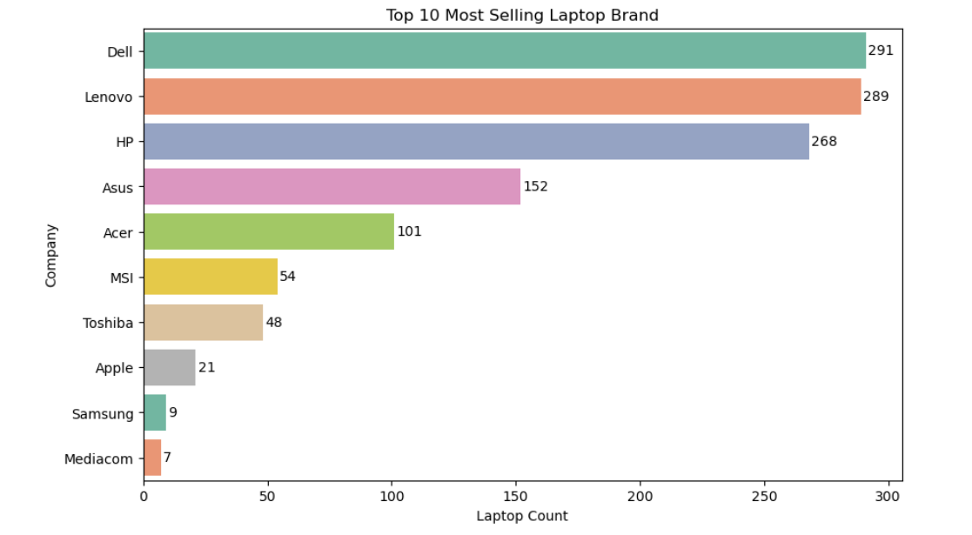
1.Top 10 Most Selling Laptop Brand
INSIGHT:
Dell leads the market with 291 units sold, closely followed by Lenovo with 289 units.
HP also maintains a strong presence with 268 units.
This data indicates that Dell, Lenovo, and HP dominate the market, potentially due to brand reputation, product availability, and consumer preferences.

Slide 11
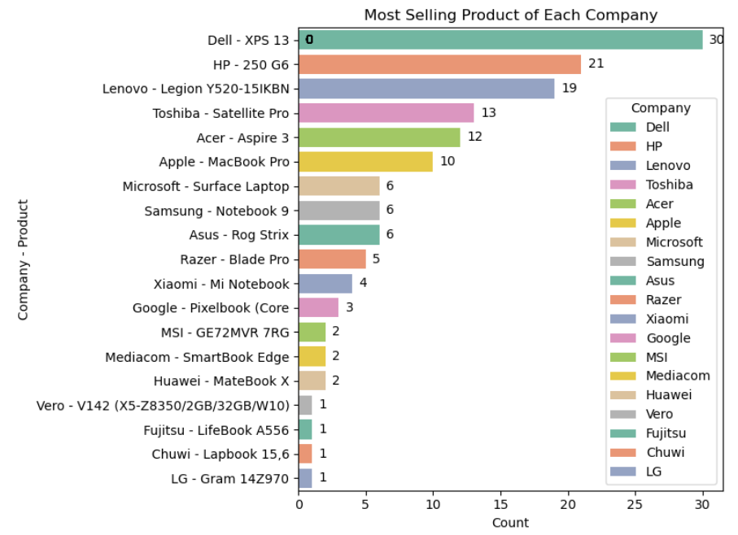
2.Most Selling Product of Each Company
INSIGHT:
THE CHART REPRESENT THE MOST SELLING LAPTOP PRODUCT FROM EACH COMPANY:
DELL XPS 13 IS THE MOST SELLING PRODUCT FOLLOWED BY HP 250 G6 , LENOVO'S LEGION Y520-15IKBN AND TOSHIBA'S SATELLITE PRO ALSO HAVE NOTABLE SALES, WITH 19 AND 13 UNITS RESPECTIVELY.
Reason why these products are top selling:
1. Premium Build Quality.
2. Top-Tier Display.
3. Performance vs Portability Balance.
4. Battery Life.
5. Brand Trust and Support.
6. Consistent Positive Reviews
.7. Appeals to Target Users.
8. Smart Product Refreshes.

Slide 12
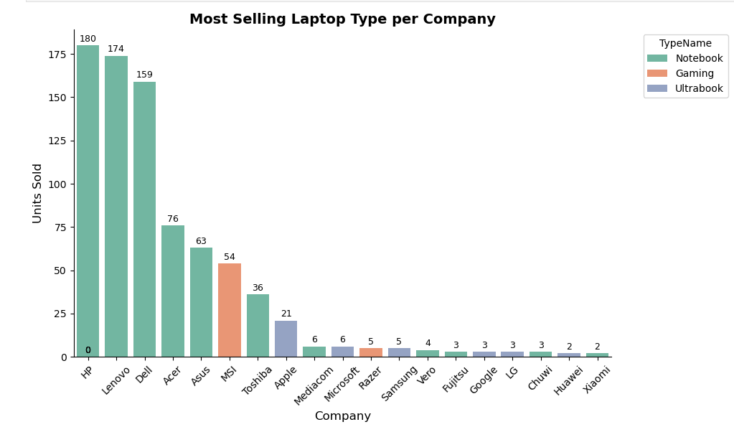
3.Most Selling TypeName Per Company
The most sold laptop TypeName is Notebook, followed by Ultrabook and Gaming laptops.
Notebook dominance is led by brands like HP, Lenovo, and Dell.
Ultrabook are primarily dominated by Apple.
Gaming laptops are mostly represented by MSI.
Notebooks are the top-selling laptop type due to their optimal balance of price, performance, and portability.
Unlike specialized laptops such as gaming models or ultrabook, notebooks are versatile, widely available, and suitable for everyday tasks.
Their wide range of configurations at affordable prices makes them a preferred choice for both personal use and institutional buyers.

Slide 13
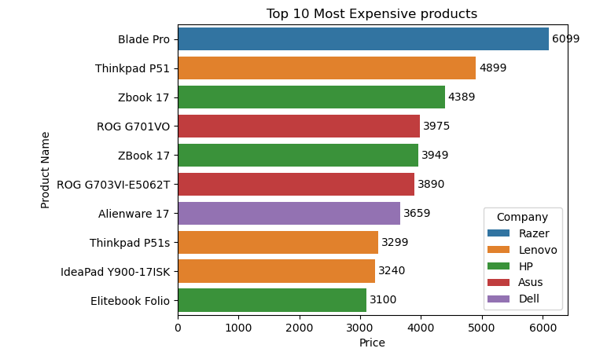
4.Top 10 Most Expensive Product(overall):
Insight:
The most expensive laptop in the dataset is the Razer Blade Pro, followed by the Lenovo ThinkPad P51 and the HP ZBook 17.
Why the Razer Blade Pro Is the Most Expensive
Equipped with high-end processors like Intel i7/i9 or AMD Ryzen 9
Features powerful RTX 3070/3080 GPUs for advanced graphics performance
Comes with 32GB RAM and 1TB SSD for fast multitasking and storage
Offers a large 17.3-inch 4K or QHD display for immersive visuals
Built with a premium aluminum body and customizable RGB keyboard
Includes advanced cooling systems and Thunderbolt 4 support for high-speed connectivity

Slide 14
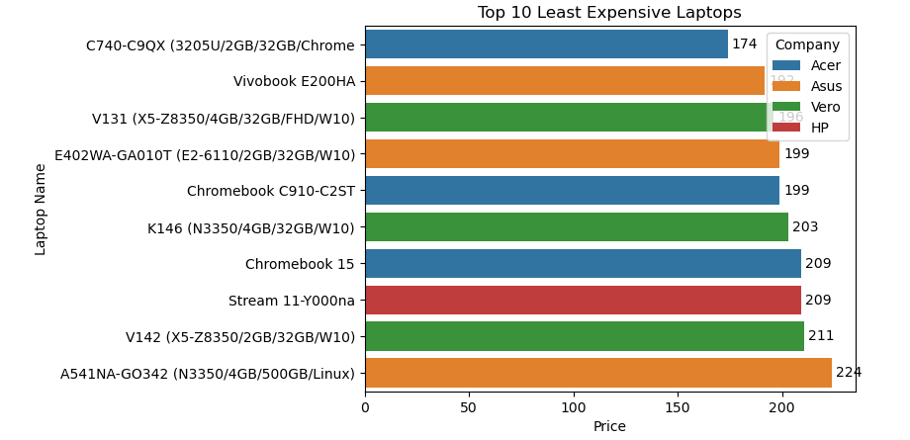
5.Top 10 Least Expensive Product (Overall)
Insight:
least expensive laptops from the chart is
C740-C9QX (3205U/2GB/32GB/Chrome) with a price of 174.
Why the C740-C9QX Is the Least Expensive
Basic CPU (Intel 3205U) for light tasks
Low RAM (2GB) limits performance
Small storage (32GB, likely eMMC)
Chrome OS for lightweight, web-based use
No premium features or materials
Designed for budget or educational use

Slide 15
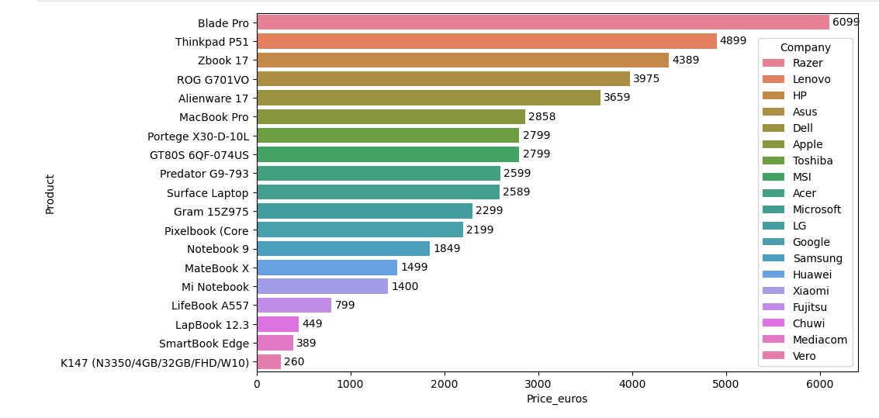
6.Most Expensive Product from each Company

Slide 16
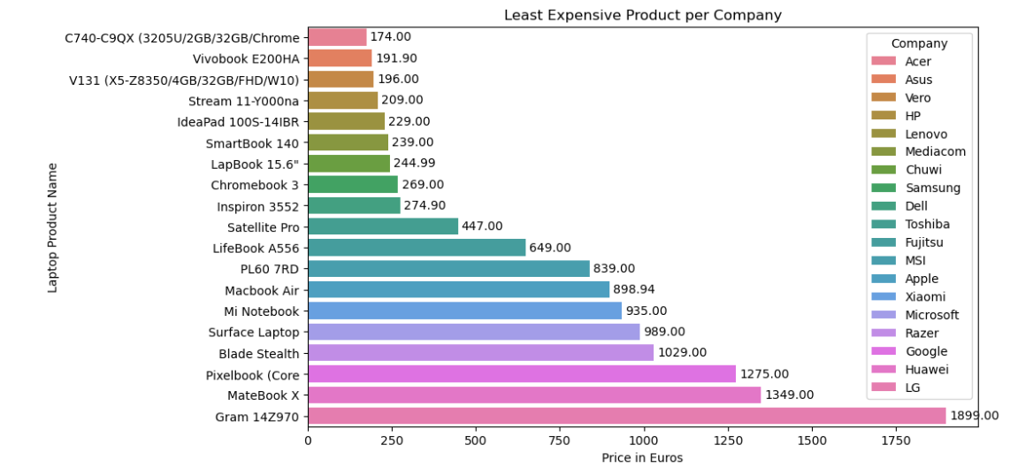
7.Least Expensive Product per Company

Slide 17
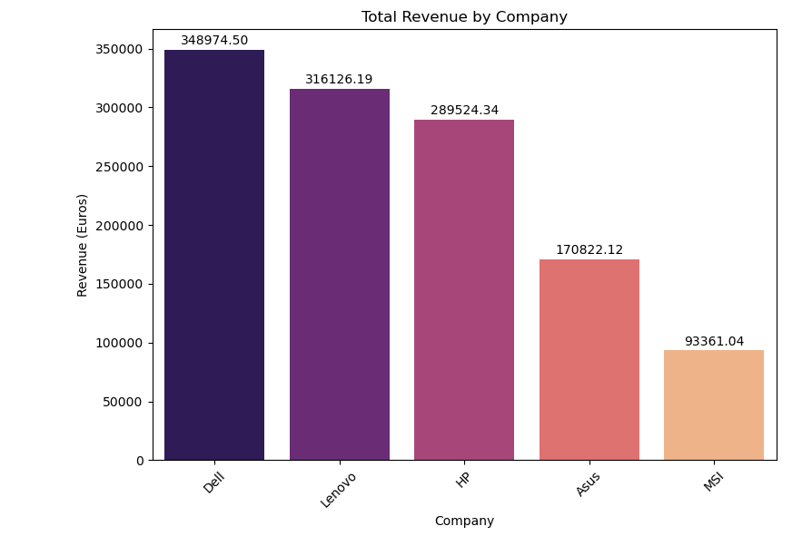
8.Top 5 Companies by Total Revenue
Insight
Dell has the highest revenue, approximately €349,974.50,
Lenovo follows closely with around €316,126.19
And HP is in third place with approximately €289,524.34.

Slide 18
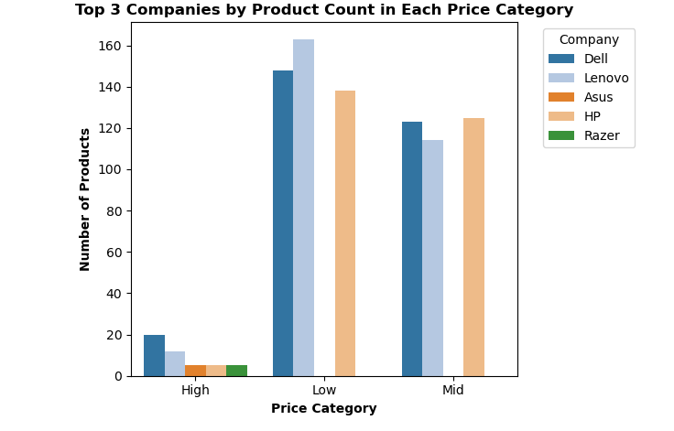
9. Companies with highest share of products sold in each Price Category:
INSIGHT:
Dell has the highest number of product count in High price category.
Lenovo has the highest number of product count in Low price Category
HP has the highest number of product count in Mid price Category:

Slide 19
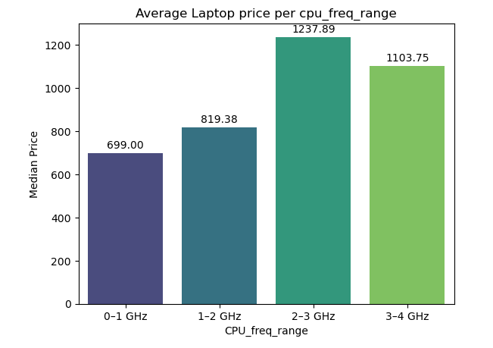
10.Average Laptop Price by CPU Frequency Range
Insight:
Laptops with a CPU frequency range between 2–3 GHz have the highest average price,
followed by those in the 3-4GHz and 1-2 GHz ranges.
CPU frequency is not the sole determinant of price. Other important factors also significantly influence laptop pricing, such as:
RAM size and type
Storage capacity and speed (SSD vs HDD)
GPU model and performance
Screen quality and resolution
Brand reputation and build quality

Slide 20
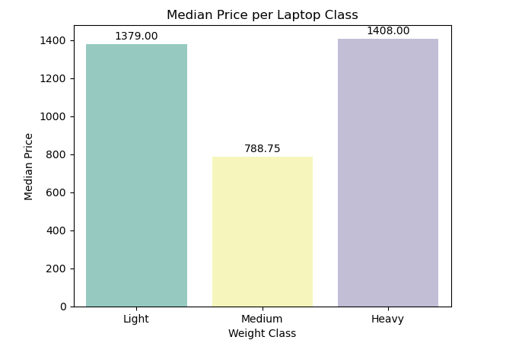
11.Median Price of Laptops by Weight Category:
Insight:
Laptops with heavy weight have the highest median price (€1408),
followed closely by lightweight laptops (€1379).
Medium-weight laptops have the lowest median price among the three categories.

Slide 21
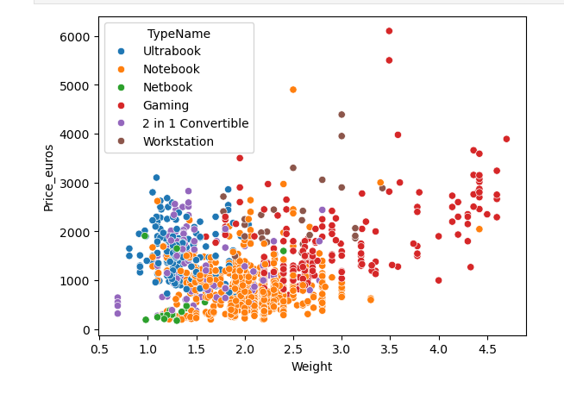
11.2 Laptop Weight vs Prices:
Insight:
Gaming laptops are the most expensive, often exceeding €2000, some reaching over €6000.
Notebooks and Workstations have wide price ranges; Workstations are heavier and costlier.
Netbooks and Ultrabooks are lighter and generally priced below €3000.
2-in-1 Convertibles mostly fall under €2000.
Heavier devices tend to be more expensive, especially in Gaming and Workstation categories.
Most laptops cluster between 1.0–2.0 kg and €500–€2000.
Netbooks are lightest and cheapest; Gaming laptops show the highest variation in both weight and price.

Slide 22
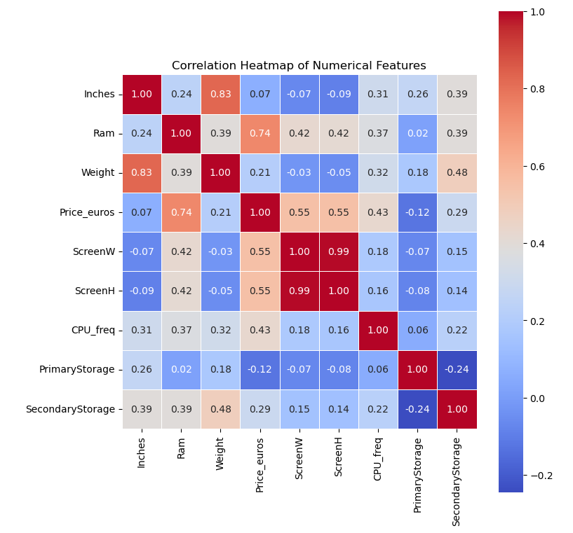
12. Correlation
Correlation Insights
Inches vs. Weight (Correlation: 0.83)
  There is a strong positive correlation between laptop screen size and weight.
  As the size (in inches) increases, the weight of the laptop tends to increase as well.
Price (Euros) vs. RAM (Correlation: 0.74)
  A strong positive correlation exists between RAM size and laptop price.
  Laptops with higher RAM are generally more expensive.
Screen Width vs. Screen Height (Correlation: 0.99)
  There is a very strong linear correlation between screen width and screen height.
  As the screen width increases, the screen height also increases proportionally, indicating consistent aspect ratios across devices.

Slide 23
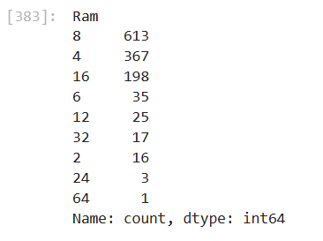
13.RAM
Most Common RAM Sizes:8 GB is the most common configuration, found in 613 laptops, indicating it is the standard choice for general users.
4 GB is the second most frequent (367 laptops), often seen in budget or entry-level models.
Higher RAM Sizes:16 GB RAM is found in 198 laptops, showing its popularity among power users and professionals.
32 GB, 64 GB, and 24 GB configurations are rare, collectively appearing in only 21 laptops, suggesting limited availability of high-performance machines.
Low RAM Configurations:2 GB RAM is present in 16 laptops, likely representing older or very low-end devices.

Slide 24
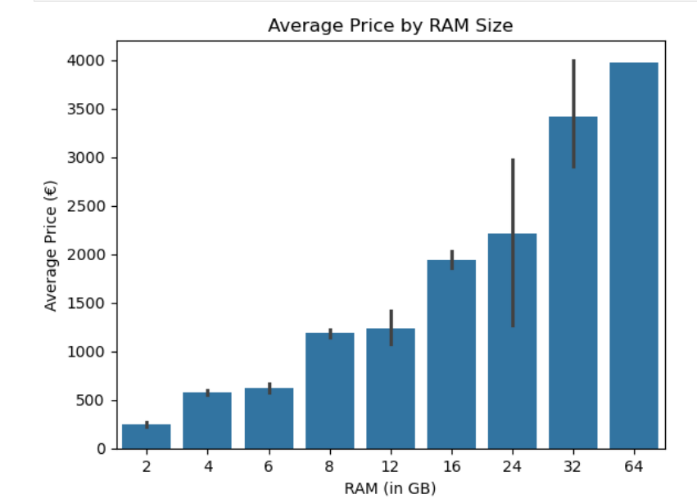
13.1 Average Price BY Ram Size:
Insight:
Laptops with higher RAM have significantly higher average prices, showing a clear upward trend.
64 GB RAM laptops are the most expensive, averaging €3975, typically found in workstations and high-end gaming devices.
32 GB and 24 GB RAM devices are also in the premium segment, averaging over €2200.
8 GB to 16 GB RAM is the mid-range sweet spot, with prices between €1180–€1940, suitable for general users and professionals.
Laptops with 2–4 GB RAM are the least expensive, averaging below €600, indicating entry-level or budget devices.

Slide 25
Other key Insights of Ram:
The Asus ROG G701VO, a gaming laptop, has the highest RAM in the dataset at 64 GB.
There are a total of 16 laptop models with the lowest RAM of 2 GB, typically entry-level or budget devices.
The Razer Blade Pro stands out with 32 GB RAM and a high price of €6099, highlighting its position as a premium high-performance laptop.

Slide 26
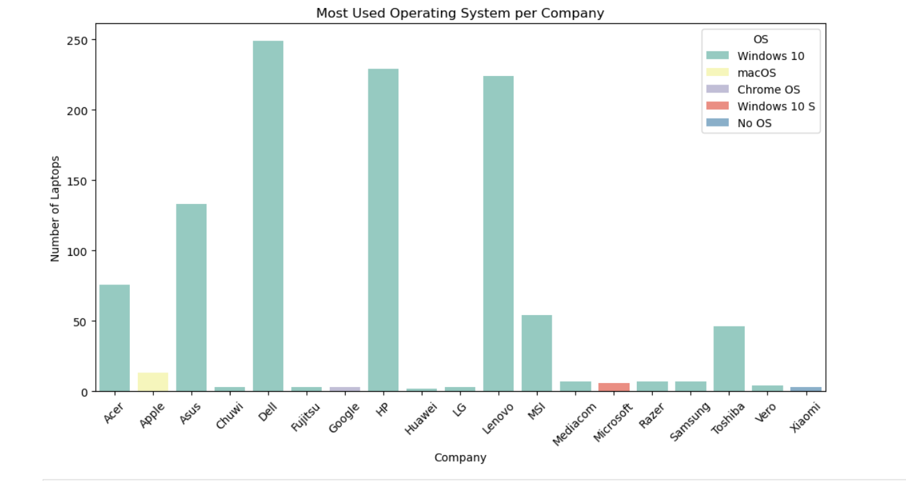
14.OS Count by Company
Most Common Operating System
Windows 10 is the most widely used operating system among laptops in the dataset, with a total count of 1,048 devices.
Other operating systems are far less common in comparison.

Slide 27
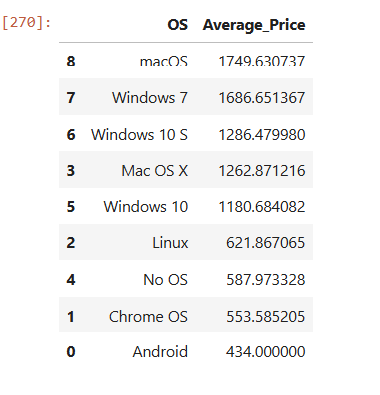
14.1 Average Laptop Price By OS:
OS vs Average Price Insight
macOS and Windows 7 laptops have the highest average prices, above €1600, indicating premium devices.
Windows 10 and Windows 10 S are mid-range in pricing.
Linux, Chrome OS, No OS, and Android laptops are the most affordable, all averaging below €650.
Android-based laptops are the least expensive, with an average price of €434.

Slide 28
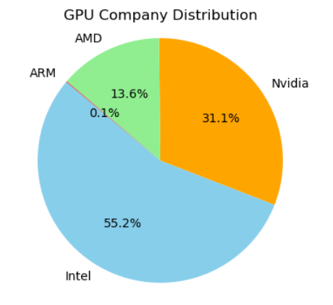
15 GPU Company Distribution
Intel holds the largest share of the GPU market at 55.2%.
NVIDIA is the second largest, with a 31.1% share.
AMD accounts for 13.6% of the market.
ARM has a very minimal presence, with only 0.1% share.
Overall, Intel clearly dominates the GPU market among the listed companies.

Slide 29
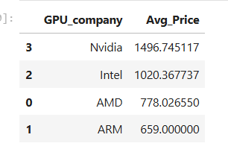
15.1 Average Price of Laptop by GPU Company
Laptops with NVIDIA GPUs have the highest average price (€1496), indicating their presence in high-performance and gaming laptops.
Intel GPU laptops are mid-range in price (€1020), commonly found in general-purpose and ultrabook devices.
AMD GPU laptops are more budget-friendly, with an average price of €778.
ARM-based GPU laptops are the least expensive, averaging just €659, reflecting their limited performance and usage scope.

Slide 30
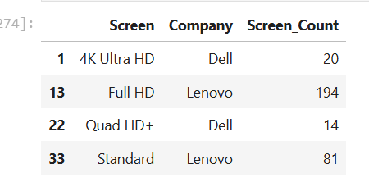
16. Company with the highest number of laptops for each screen type:
Lenovo shows strong dominance across both Full HD and Standard resolutions, highlighting its broad product portfolio from budget to mid-range.
Dell is focusing more on high-resolution screens like 4K Ultra HD and Quad HD+, indicating a push toward premium and professional markets.

Slide 31
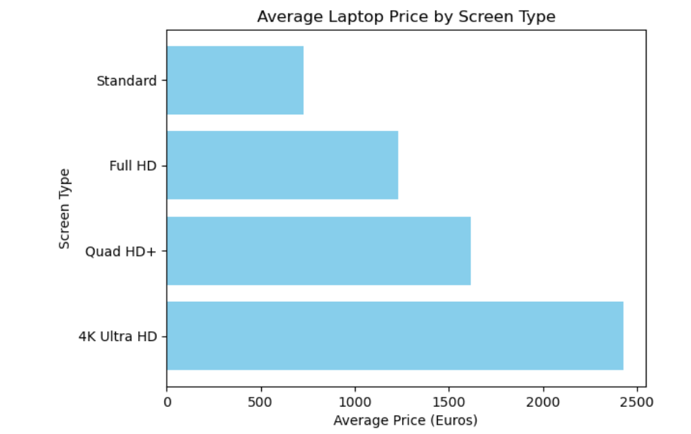
16.1.Average Price of Laptops BY Screen Type:
4K Ultra HD: Highest average price ($2,424.76) — used in premium, professional-grade laptops.
Quad HD+: Mid-high range ($1,616.96) — offers sharp visuals at a slightly lower cost than 4K.
Full HD: Most common and balanced option ($1,231.20) — ideal for general users.
Standard: Lowest average price ($730.33) — found in budget or entry-level laptops.

Slide 32
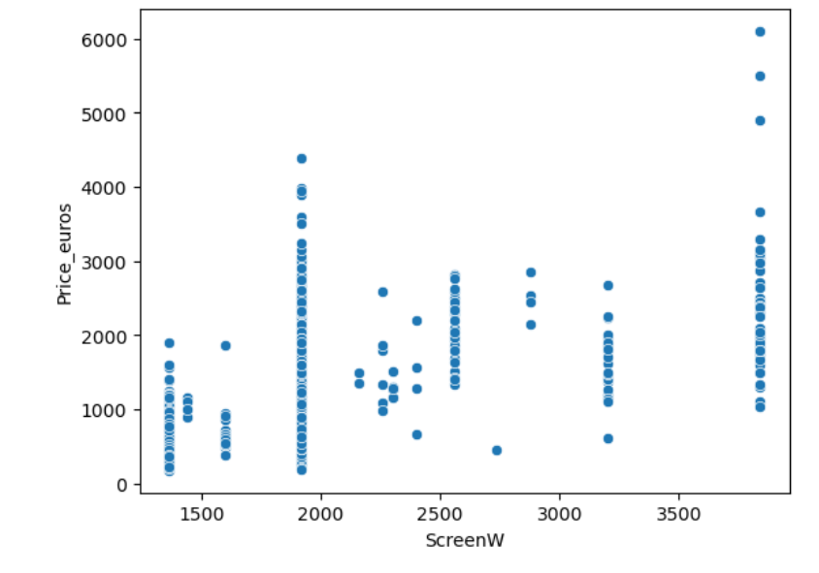
17 Screen Width
Insight:
The data shows that laptop prices vary a lot based on screen width — from just a few hundred euros to over 6,000 euros.
In general, larger screen widths often cost more, but this isn't always true.
Some smaller screens are very expensive, and some larger ones are cheaper.
This means that price doesn’t depend only on screen size — other things like brand, features, and build quality also play a big role. Overall, the laptop market is very diverse, with a wide range of prices for all kinds of screen sizes.
Other Insight:
Maximum number of Laptops(838) has the ScreenW (1920)
Laptops with the Screen W (2880) has the highest Average_Price(2493.84)

Slide 33
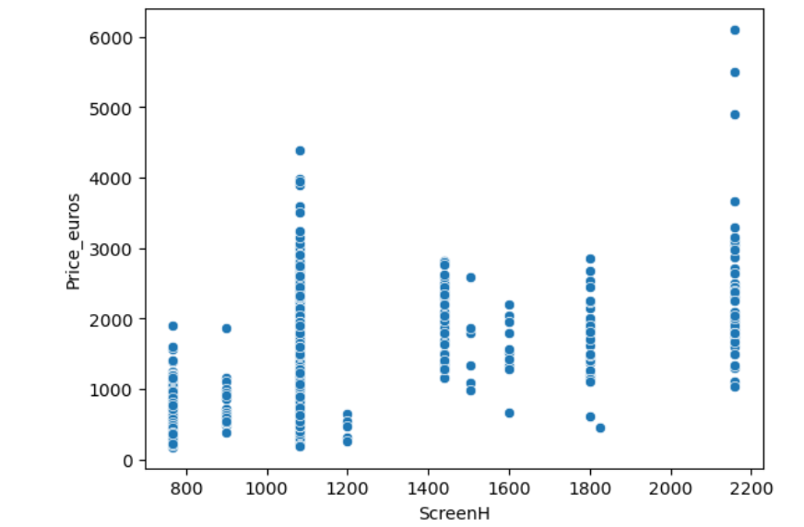
17.ScreenH
Insight:
The scatter plot shows that while laptops with higher screen heights often cost more, the relationship isn't consistent.
Prices vary widely—even among laptops with similar screen heights—indicating that factors like brand, features,
and performance also play a major role. Overall, the market is diverse, and screen height alone doesn't determine price
Other Insight:
Maximum number of Laptops(833) has ScreenH(1080)
Laptops with the ScreenH(2160) has the highest mean_price(2424.76)

Slide 34
18. Type Screen , IPS PANEL , Retina Display:
1. All laptops in out dataset are Touch Screen.
2. IPS stands for In-Plane Switching — it's a type of LCD display technology used in many laptop screens.
In our dataset all laptops contains the IPS panel technology.
3. Retina Display is a marketing term by Apple for screens that have such a high pixel density that the human eye cannot see individual pixels at a normal viewing distance.
In Our Dataset all laptops have the Retina Display.

Slide 35
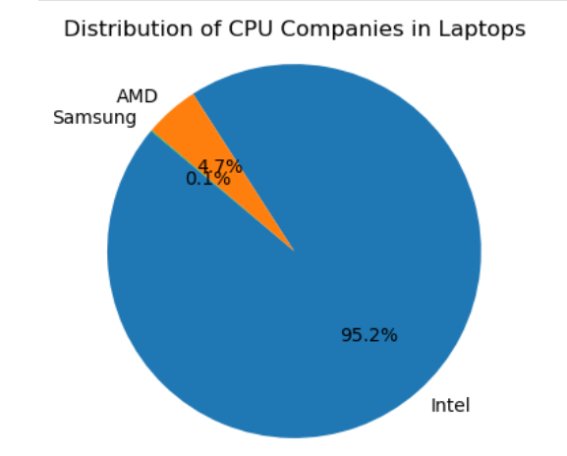
21. CPU Company
Insight:
Intel dominates the market, accounting for 95.2% of laptops with CPU companies.
AMD has a small presence, making up 4.7% of the market.
Samsung has a minimal share, representing only 0.1%.

Slide 36
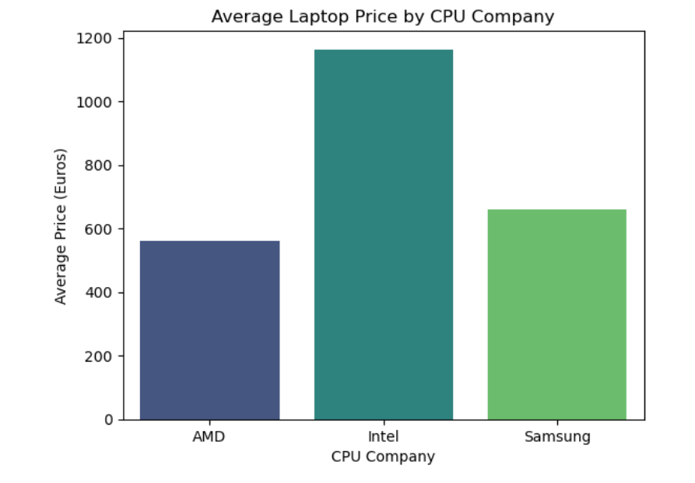
21.1 Average Price By CPU company:
Insight
Intel-based laptops have the highest average price (€1163.73), indicating their dominance in mid-to-high-end and performance-focused devices.
Samsung CPU laptops are moderately priced (€659), likely used in niche or compact devices.
AMD-based laptops have the lowest average price (€560.99), reflecting their popularity in budget-friendly and value-for-money segments.

Slide 37
22.Cpu Model: Top 5 Most Frequent CPU Model
CPU Model | Count | Insight
Core i5 7200U | 193 | Most commonly used CPU — a popular mid-range processor suitable for office work, browsing, and light multitasking.
Core i7 7700HQ | 147 | A high-performance quad-core CPU, often found in gaming and high-end laptops.
Core i7 7500U | 133 | A power-efficient i7, commonly seen in ultrabook and thin premium laptops, balancing performance and energy use.
Core i3 6006U | 81 | An entry-level processor, mostly used in budget or student laptops for basic tasks.
Core i7 8550U | 73 | A newer 8th-gen quad-core i7, featured in modern ultrabook , highlighting a shift toward better multi-core performance in slim devices.

Slide 38
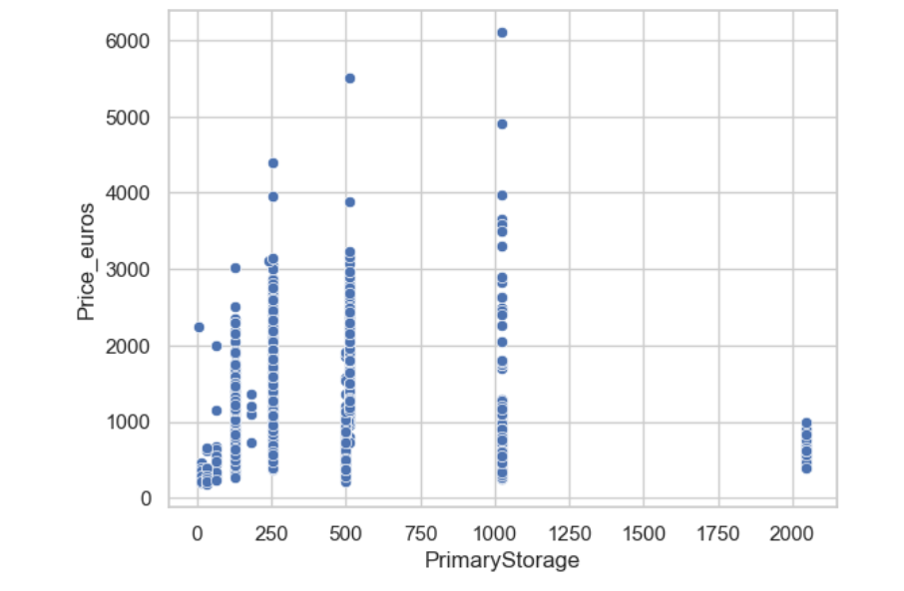
23 .Primary Storage:
# Insight:
The scatter plot shows that laptops with smaller storage (≤500 GB) span a wide price range, from budget to high-end.
As storage increases laptops become less common, especially above 1000 GB, often appearing in premium models.
While higher storage can increase price, it's not the only factor — many laptops with similar storage have very different prices, suggesting that brand, performance, and features also heavily influence cost.
Other Key Insight:
Most common Primary storage in Laptops is 256 gb (508 Laptops) followed by 1024 gb(240 laptops) , 128 gb (175 laptops)
.The least common primary storage are ( 16gb , 180gb , 240gb , 8gb , 508gb)

Slide 39
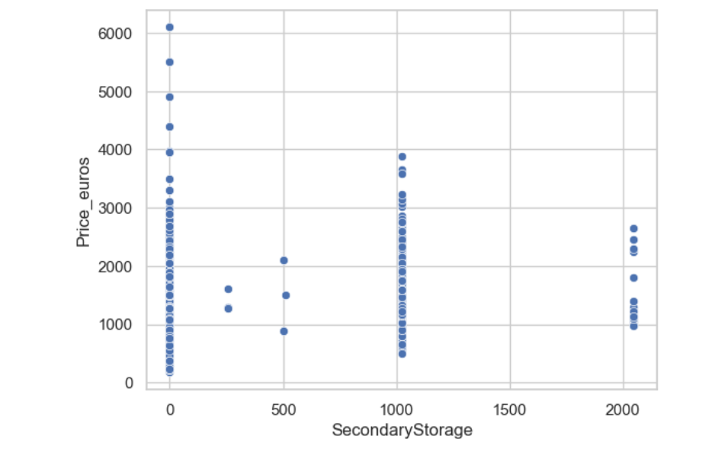
24 .Secondary Storage:
The scatter plot shows that secondary storage capacity has little direct impact on laptop prices.
Laptops with low or mid-range storage (0–1000 GB) span a wide price range, and even high-capacity models aren’t always the most expensive.
This suggests that other features like CPU, GPU, and brand play a bigger role in determining price.
Storage is important, but not the main driver of laptop cost.
Other Key Insight:
Most of the Laptops (1067) donot have secondaryStorage while 187 laptops have 1024gb secondarystorage ,15 laptops have 2048 secondarystorage.
The least common secondary storage are 256gb(3 laptop), 500gb(2 laptop) , 512gb( 1 laptop).

Slide 40
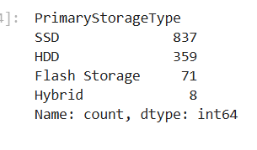
25. Primary Storage Type:
1.SSD is the dominant storage type, found in 837 laptops, highlighting its popularity due to speed and efficiency.
2.HDDs are still fairly common with 359 units, likely due to their larger storage capacity at lower cost.
3.Flash Storage appears in 71 laptops, typically in lightweight or budget models.
4.Hybrid storage is the least common, with only 8 laptops, indicating minimal use of combined SSD + HDD setups.

Slide 41
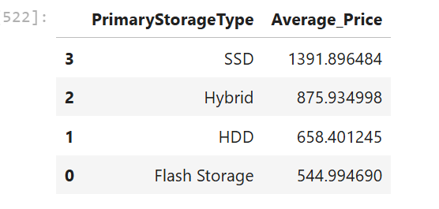
25.1 Average Price of Laptops BY Primary Storage Type
1.SSDs are associated with the highest average price (€1391.90), reflecting their performance advantages and common use in premium models.
2.Hybrid storage has a moderate average price (€875.93), indicating a balance of speed and capacity.
3.HDD-based laptops average at €658.40, often found in budget or older systems.
4.Flash Storage laptops have the lowest average price (€544.99), suggesting use in low-cost, ultra-portable devices.

Slide 42
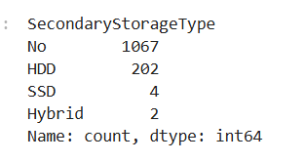
26.Secondary Storage Type
1 A majority of laptops (1067) have no secondary storage, highlighting a market trend toward single-storage configurations (usually SSD-only).
2.HDDs are the most common form of secondary storage (202 laptops), likely added for extra capacity alongside a primary SSD.
3.Very few laptops have secondary SSDs (4) or Hybrid drives (2), indicating that these configurations are rare and likely limited to high-end or niche use cases.

Slide 43
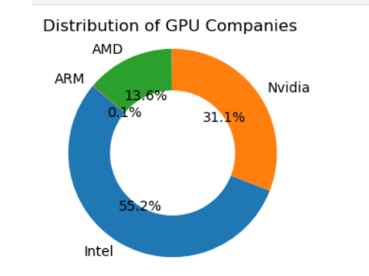
27.Gpu Company:
1.Intel holds the largest share at 55.2%, indicating a dominant position in the GPU market.
2.Nvidia is the second-largest with 31.1%, closely trailing Intel, highlighting strong competition.
3.AMD and ARM have significantly smaller shares, at 13.6% and 0.1% respectively, suggesting a much smaller presence in the GPU market.

Slide 44
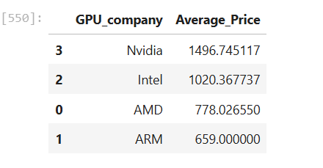
27.1 Average Price BY GPU Company:
1.Nvidia-powered laptops have the highest average price (~€1497), indicating their presence in high-performance or gaming laptops.
2.Intel GPUs follow with an average of ~€1020, often found in mid-range laptops.
3.AMD laptops average ~€778, showing a balance of performance and affordability.
4.ARM-based GPUs have the lowest average price (~€659), typically used in entry-level or lightweight devices.

Slide 45
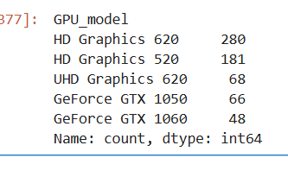
28. Most frequent GPU MODEL used by Laptop Company
1.Intel HD Graphics 620 is the most common GPU in the dataset (280 laptops), followed by HD Graphics 520 (181 laptops). These are integrated GPUs, commonly found in budget and productivity laptops.
2.UHD Graphics 620 (68 laptops) also indicates a preference for Intel's integrated solutions in newer models.
3.Nvidia GeForce GTX 1050 (66 laptops) and GTX 1060 (48 laptops) are the most popular dedicated GPUs, typically seen in gaming or high-performance laptops.

Slide 46
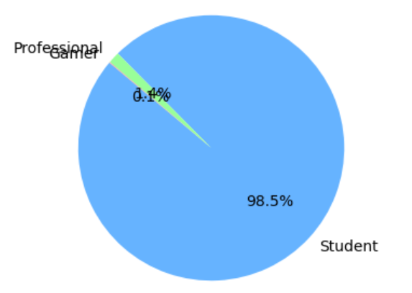
29.User Segment Analysis
Insight:
Students dominate laptop distribution at 98.5%, while Professionals hold about 1.4 % and Gamers hold about 0.1%

Slide 47
Conclusion:
Laptop price is mainly driven by RAM , CPU, Storage and Display Quality
1.Performance Components Drive Price:
Laptops with high-end Intel or AMD CPUs, dedicated NVIDIA GPUs, and SSD storage are significantly more expensive.
RAM shows a strong positive correlation (0.74) with price, confirming it as a major cost factor.
2. Storage Type and Capacity Matter:
SSDs dominate modern laptops for speed and reliability, replacing HDDs in most models.
Storage capacity alone doesn’t dictate price — premium devices often have less storage but faster SSDs.
3. Display and Build Quality Add Premium Value:
4K and Retina displays, along with IPS technology, are found in higher-priced laptops due to their superior visuals.
Premium design and lightweight builds increase price even in mid-range configurations.

Slide 48
Conclusion:
4. Brand and Market Position:
Dell, Lenovo, and HP dominate in both sales and revenue, driven by product range and customer trust.
Apple commands a premium due to its exclusive macOS and design ecosystem.
5. User Segmentation:
Students make up 98.5% of users, showing demand for affordable, all-rounder devices.
Professionals (1.4%) and gamers (0.1%) represent niche, high-value segments with potential for targeted marketing.
6.Price Distribution Patterns:
Mid-range laptops (8–16 GB RAM, SSD, Intel i5/i7 CPUs) form the core of the market, balancing performance and affordability.
Ultra-premium laptops (32–64 GB RAM, NVIDIA GPUs, 4K screens) cater to professionals and creators.

Slide 49
Recommendations:
Following recommendations can help manufacturers, retailers, and marketers optimize pricing, improve sales, and align products with consumer demand:
1. Expand Mid-Range Offerings (8–16 GB RAM, SSD, i5/i7 CPUs)
Most customers fall within this range — offer multiple configurations and emphasize performance-for-value.
Target students and professionals with affordable yet capable models.
2. Promote SSD-Only Configurations
Market SSDs as a major performance upgrade and phase out HDD-only options.
Use hybrid (SSD + HDD) models for creative or enterprise users needing large storage.
3. Differentiate Product Lines by Audience
Students: Affordable notebooks with 8 GB RAM and SSDs.
Professionals: Lightweight ultrabooks with long battery life and Full HD displays.
Gamers/Creators: Laptops with NVIDIA GPUs, 16–32 GB RAM, and 4K screens.
4. Invest in Display and Design Innovation
Enhance visual quality across models — even mid-range laptops can benefit from IPS or high-refresh displays.
Use premium build materials and sleek form factors to boost perceived value.

Slide 50
Recommendations:
5. Use Data-Driven Pricing and Bundling
Offer promotional bundles (Office suite, antivirus, warranty) to add value.
Analyze demand trends to dynamically adjust pricing and avoid overstock of low-demand models.
6. Increase Focus on GPU-Driven Segments
With the rise of gaming, design, and AI-related workloads, prioritize NVIDIA and AMD GPU laptops.
Develop co-marketing campaigns with GPU and CPU brands.
7. Leverage Brand Strength and Reputation
Highlight brand reliability (e.g., Dell’s durability, Lenovo’s business performance, HP’s versatility).
Encourage positive user reviews and testimonials to drive brand trust.
8. Explore Growth in Premium and Professional Segments
Introduce performance-focused laptops with high RAM (32–64 GB) and 4K screens for business users.
Promote these as long-term investments with durability and top-tier specs.

